Slide 1
Western Engineering Competition (WEC) Presentation
David, Neelesh, Mila

Slide 2
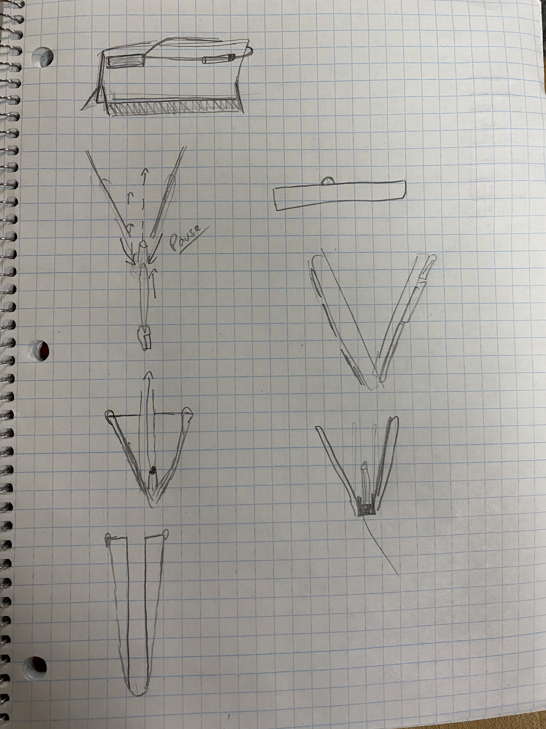
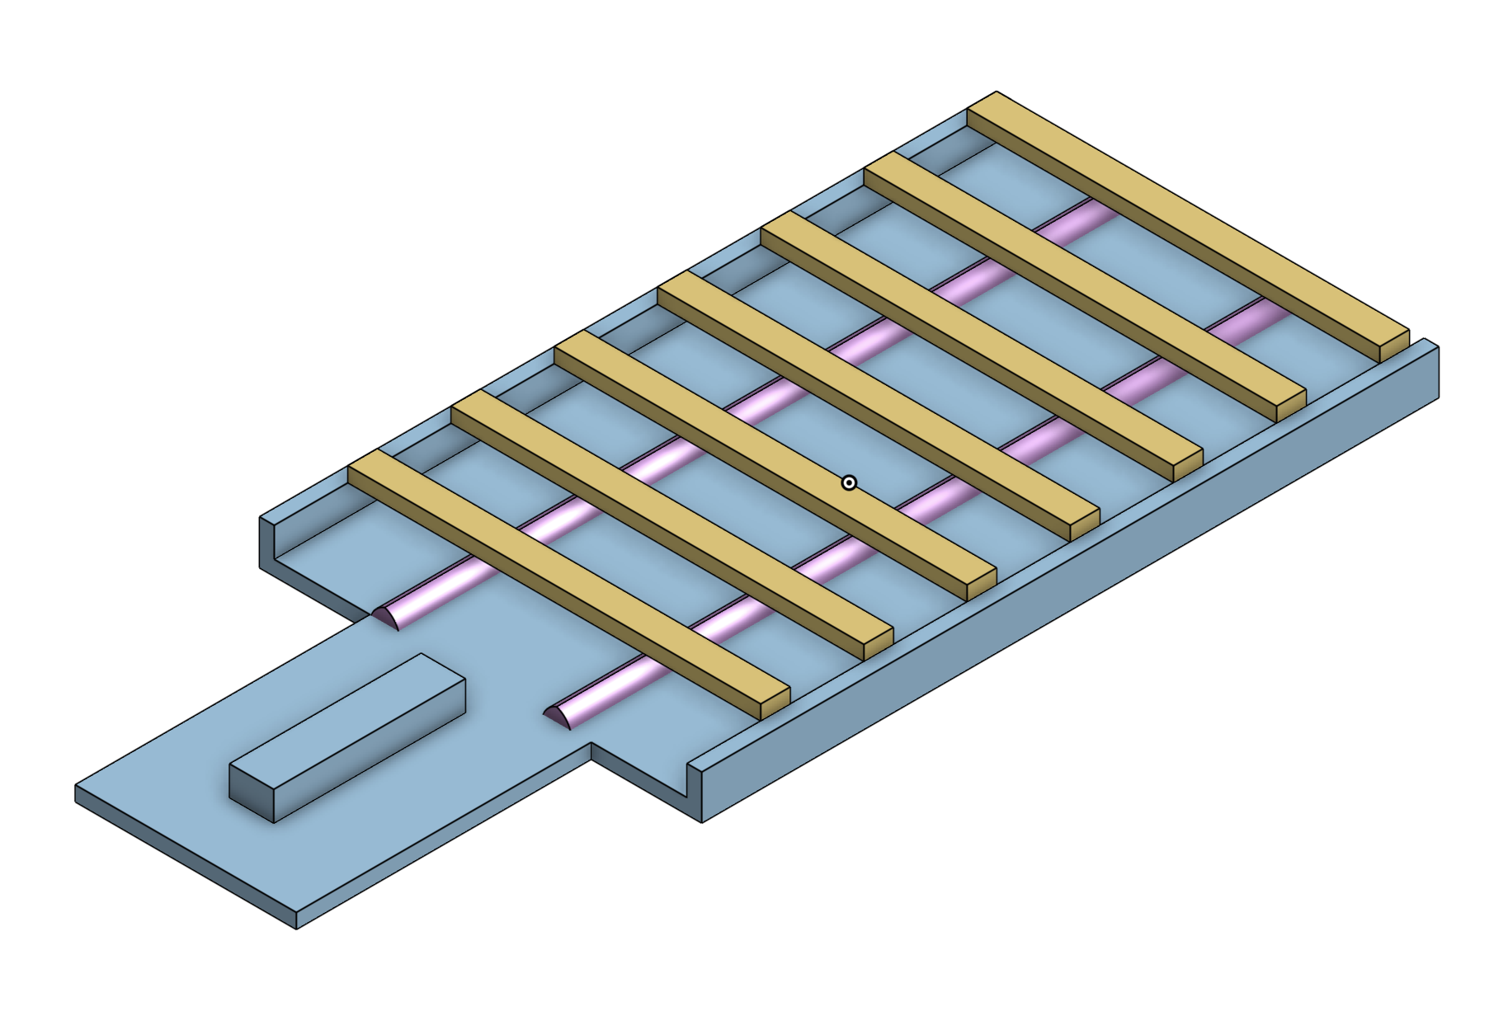
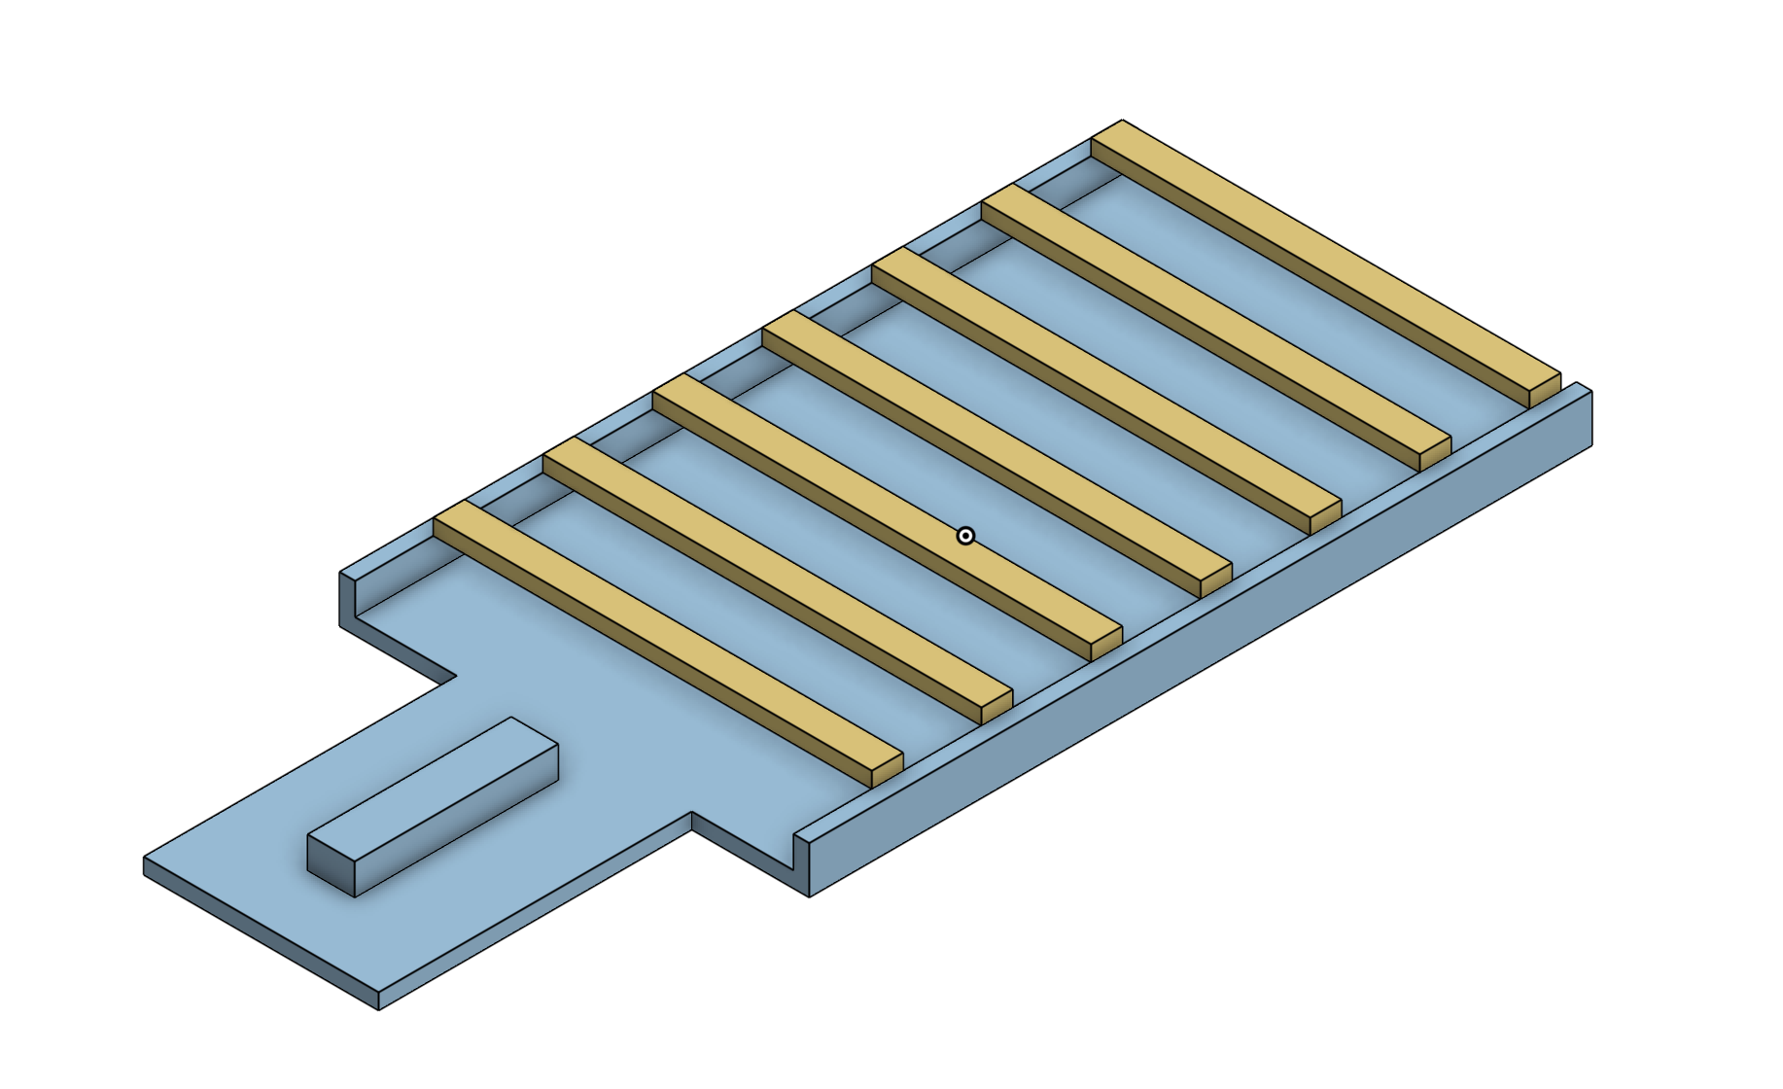
1
Design Process
1. Side Crossbow (clothespin on the side)
2. Slingshot
3. Slingshot with channel to guide bullet
2
3

Slide 3
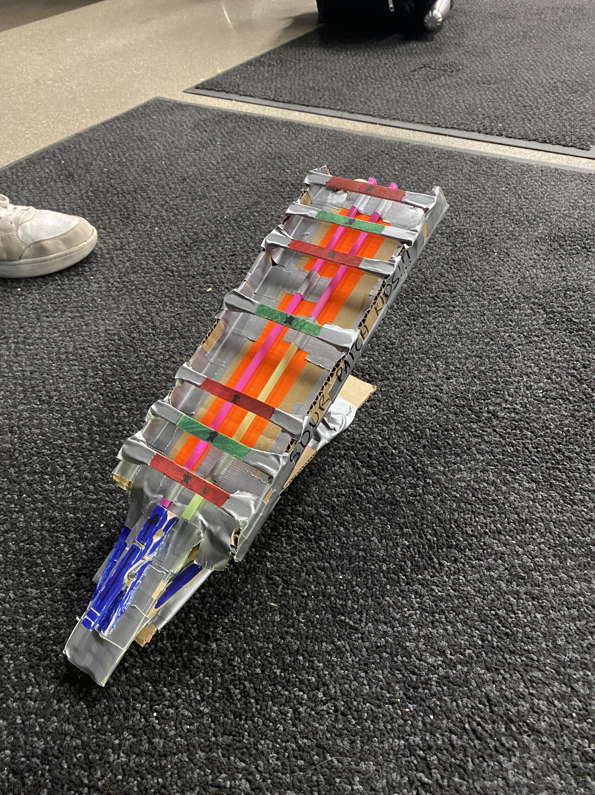

Modelling Final
Notches for rubber bands
Popsicle sticks
Straw Channels
Clothespin

Slide 4
Final Design
Elevated and angled off the floor
Tape along the bullet channel to reduce friction
Clothespin release trigger
Popsicle sticks along the top and straws on side to prevent bullet from straying from path
Clothespin
Straw channels

Slide 5
Using Materials
1
Straws: Made channels to guide bullet, ensuring proper trajectory
Clothespin: Used as a release mechanism for the rubber bands
Cardboard: Used as stand for projectile contraption
Rubber Band: Recoil of rubber band used to apply initial force to dart

Slide 6
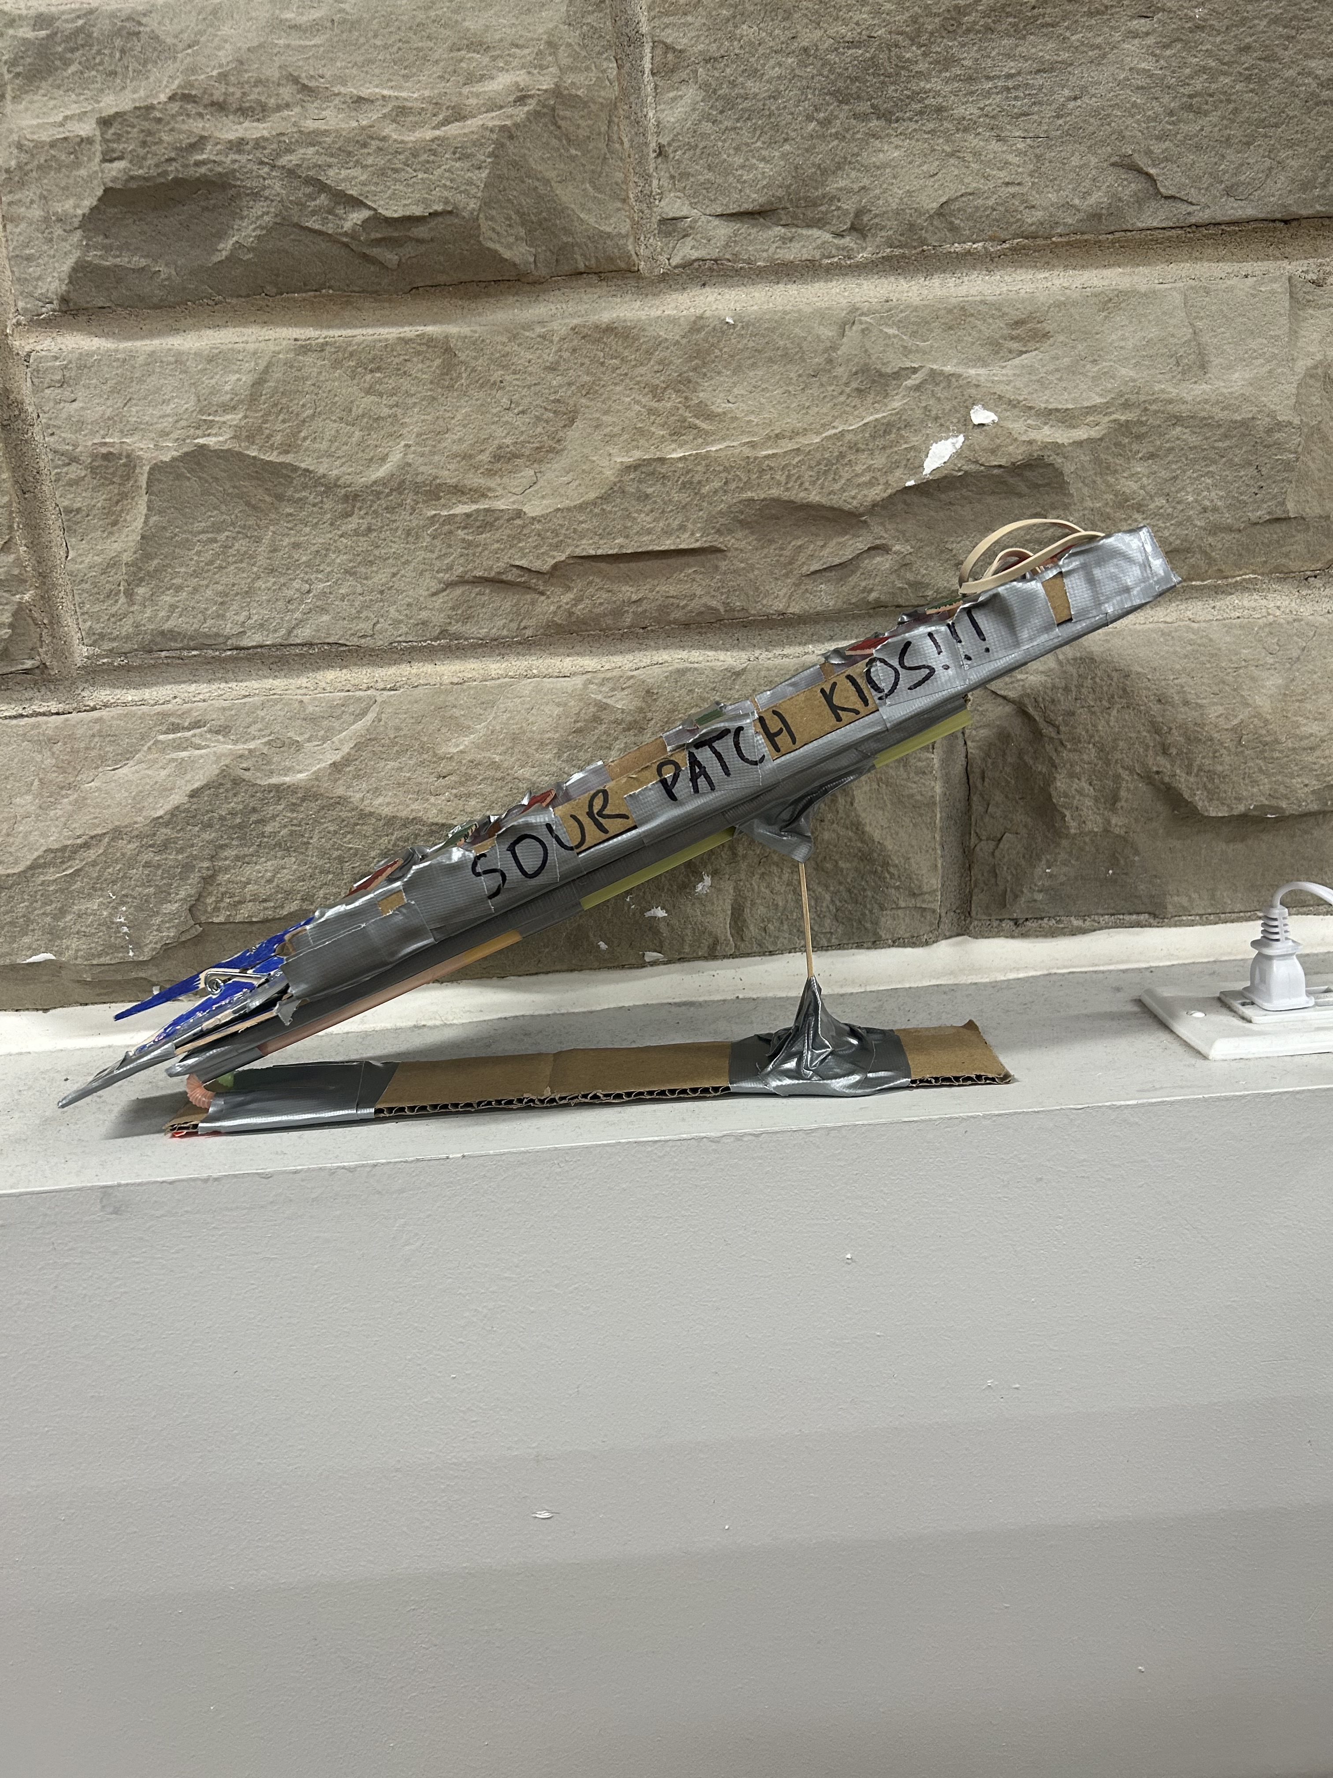




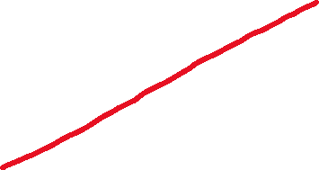



Optimizing Distance + Performance
Most optimal angle found through trial and error was ~30 degrees.
Maximizes the horizontal distance travelled
Straws are placed to create a pathway to guide the dart and ensure accuracy
Straws have a low coefficient of friction (0.17 to 0.42)
Tied two rubber bands together to launch the bullet
Ensures contraption can be pulled back far enough
Found that three rubber bands was too much force

